Slide 1

Recommendations for Big Mountain Resort
BY: Marko Glodovic

Slide 2
Problem:
● Big Mountain Resort has recently installed an additional chair lift to help increase the distribution of visitors across the mountain. This additional chair increases their operating costs by $1,540,000 this season.
● Given the current ticket price is $81 per adult - BMR needs to find a way to increase revenue to cover this added cost.
● The business wants some guidance on how to select a better value for their ticket price.

Slide 3
Recommendations:
The model was trained and optimized with the provided resort data. The actual ticket price is $81.00. And the model result price is $94.22. This suggests that there is room for an increase, with an expected mean absolute error of $10.39 and standard deviation of $1.47.
Do not close runs, closing up to 10 runs will decrease ticket price by $3 and result in significant revenue loss without a significant drop in operational costs
Future investment in adding a chairlift and run to increase vertical drop by 150 feet could significantly lift ticket prices ($8.61-$9.90 depending on snow making capabilities

Slide 4
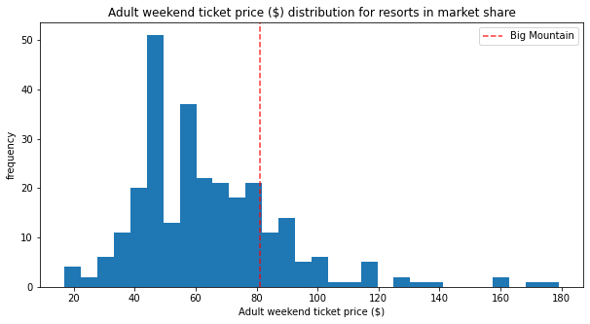
Ticket price
Big Mountain Resort sits at the top end of its market segment for price:

Slide 5
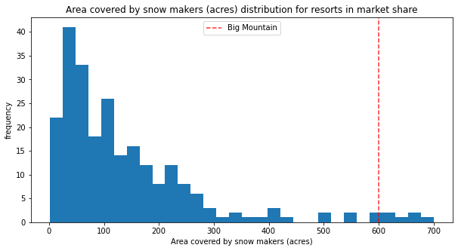
Area covered by snow:
Big Mountain is very high up the league table of snowmaking area.

Slide 6
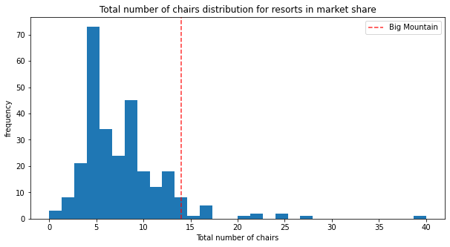
Total number of chairs:

Slide 7
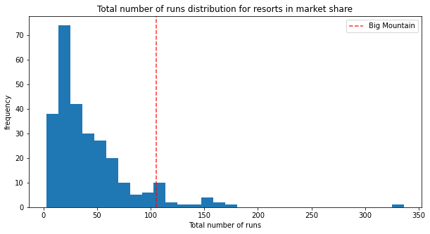
Total number of runs:
Big Mountain is in middle of pack regarding number of runs.

Slide 8
Summary:
This supports the models recommendation in increasing the ticket price to approximately $95. Even if we assume the maximum error of approximately $10 this market calibration suggests that at minimum Big Mountain increase its ticket price to $85, or less conservatively into the $90-$95 range.
Adding to Vertical Drop, number of Runs, Total Chairs, and number of chairs is the best way for Big Mountain Resort to add value to their tickets in future.

